Slide 1
Introduction to Quantum Computing: From a Layperson to a Programmer in 30 Steps
Hiu-Yung Wong
https://link.springer.com/book/10.1007/978-3-030-98339-0
https://www.amazon.com/Introduction-Quantum-Computing-Layperson-Programmer/dp/3030983382
Playlist: https://www.youtube.com/watch?v=P9rYlwK0r7I&list=PLnK6MrIqGXsJfcBdppW3CKJ858zR8P4eP&index=1&t=990s
https://www.youtube.com/watch?v=LFu8FSRzC4g&list=PLnK6MrIqGXsJfcBdppW3CKJ858zR8P4eP&index=2

Slide 2
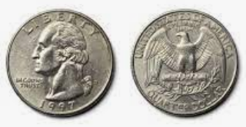
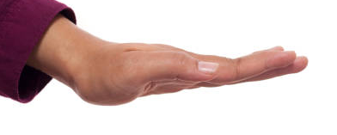
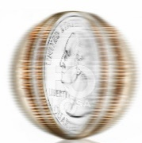









Measurement
$${\left|α\right|}^{2}$$
$$\left.\left|0\right.\right\rangle$$
$$\left.\left|ψ\right.\right\rangle =\left.α\left|0\right.\right\rangle \left.+β\left|1\right.\right\rangle$$
M
$$\left.\left|1\right.\right\rangle$$
$${\left|β\right|}^{2}$$

Slide 3
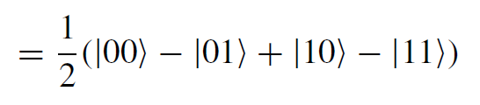
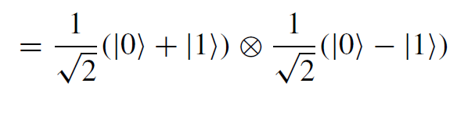

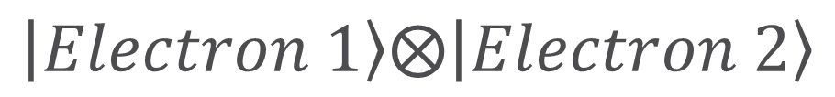
Entangled States
Unentangled State
Electron 1
Electron 2
Entangled State: Used in quantum computing algorithms and also quantum communications
$$\left.\left|Electron 1\right.\right\rangle ⨂\left.\left|Electron 2\right.\right\rangle$$

Slide 4
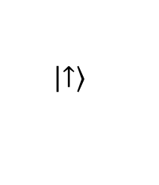

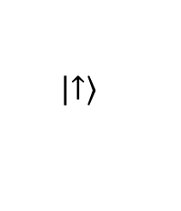

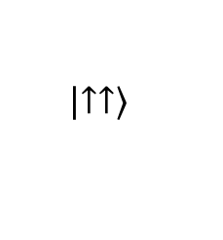

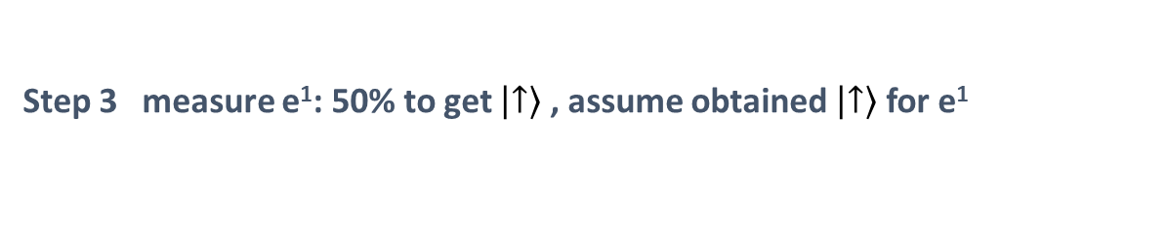
Quantum Entanglement – Spooky Action
$$Φ^{+}=\frac{1}{\sqrt{2}}\left(\left.\left|↑↑\right.\right\rangle +\left.\left|↓↓\right.\right\rangle \right)$$
Step 1
e¹
e²
Step 2
Earth
$$Φ^{+}=\frac{1}{\sqrt{2}}\left(\left.\left|↑↑\right.\right\rangle +\left.\left|↓↓\right.\right\rangle \right)$$
100 light years away
e¹
still entangled
e²
Step 3 measure e¹: 50% to get $\left.\left|↑\right.\right\rangle$ , assume obtained $\left.\left|↑\right.\right\rangle$ for e¹
collapse
$$Φ^{+}$$
$$\left.\left|↑↑\right.\right\rangle$$
$$\left.\left|↑\right.\right\rangle$$
Earth
100 light years away
$$\left.\left|↑\right.\right\rangle$$
e¹
e²

Slide 5
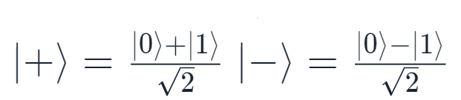

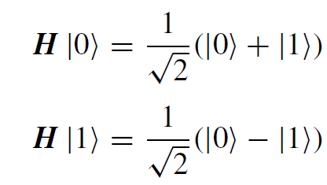






Quantum Gates
Bloch Sphere
$$\left|\left.0\right\rangle \right.$$
Quantum gates rotate the vector (state) in the corresponding hyperspace
Very often, a gate is just a laser or microwave pulse
Some gates have classical counterparts
NOT gate (1-qubit)
CNOT gate (2-qubit)
Some gates have no classical counterparts
Hadamard gate
$$\left|\left.Ψ\right\rangle \right.$$
θ
$$\left|\left.−\right\rangle \right.$$
$$φ$$
$$\left|\left.+\right\rangle \right.$$
$$\left|\left.1\right\rangle \right.$$
We embed the hyperspace of a qubit in our real 3D space

Slide 6
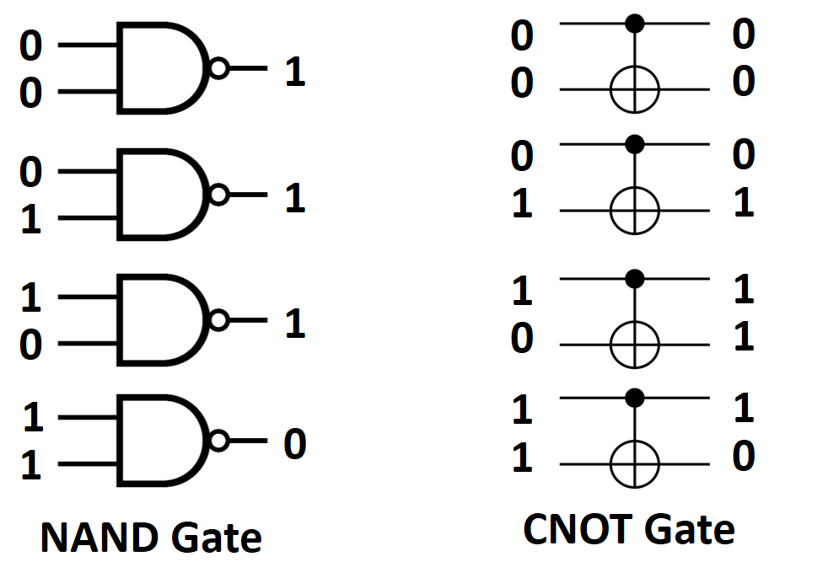
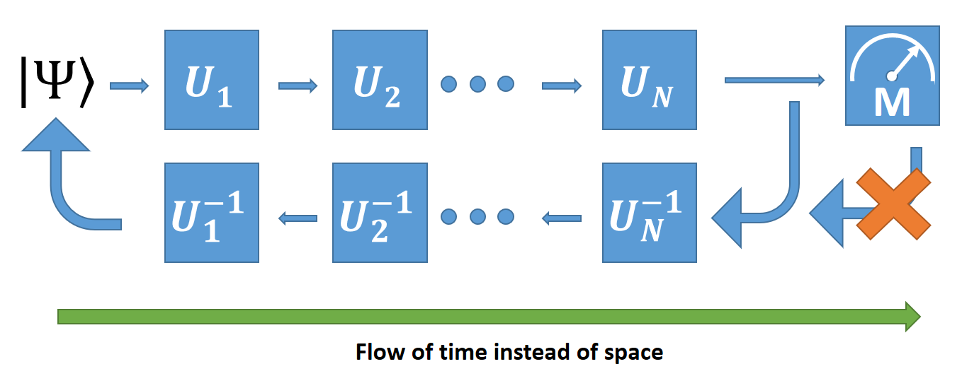
Quantum Gates and Circuits
Quantum gates must be reversible
Quantum circuit is the application of operations (microwave/laser pulses) to usually stationary qubit carriers.

Slide 7


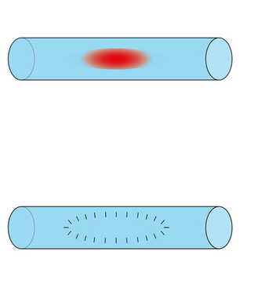
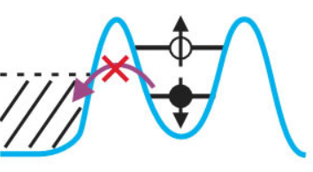
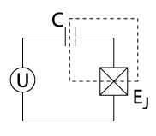



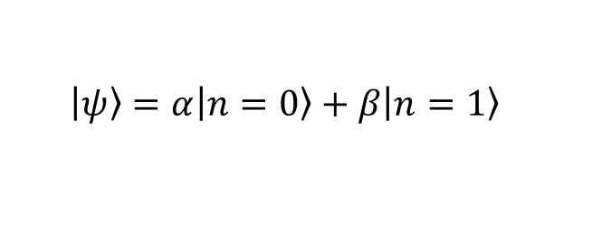

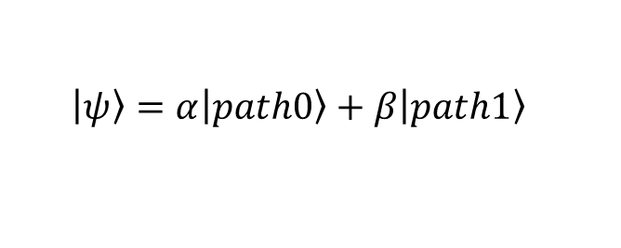
Implementations of Qubits
$$\left.\left|Mood\right.\right\rangle =α\left.\left|\right.\right\rangle +β\left.\left|\right.\right\rangle$$
Not a reliable qubit
Electron Spin Qubit
Photonic Qubit
Superconducting Charge Qubit
$$path1$$
$$n$$
$path$0
$$\left.\left|\right.\right\rangle =α\left.\left|\right.\right\rangle +β\left.\left|\right.\right\rangle$$
$$\left.\left|ψ\right.\right\rangle =α\left.\left|path0\right.\right\rangle +β\left.\left|path1\right.\right\rangle$$
$$\left.\left|ψ\right.\right\rangle =α\left.\left|n=0\right.\right\rangle +β\left.\left|n=1\right.\right\rangle$$
Physics Today 72, 8, 38 (2019)
Scientific Reports 3, 1394 (2013)
Wikipedia

Slide 8
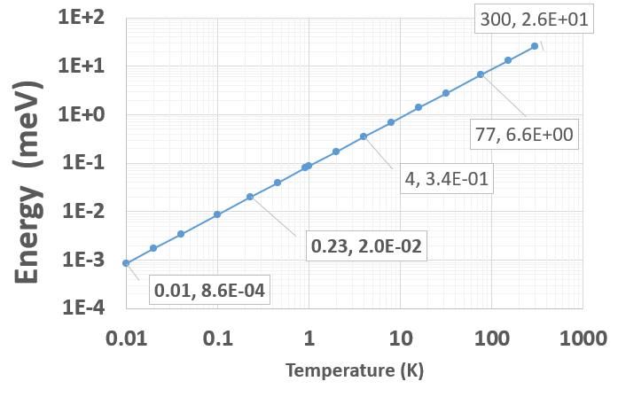
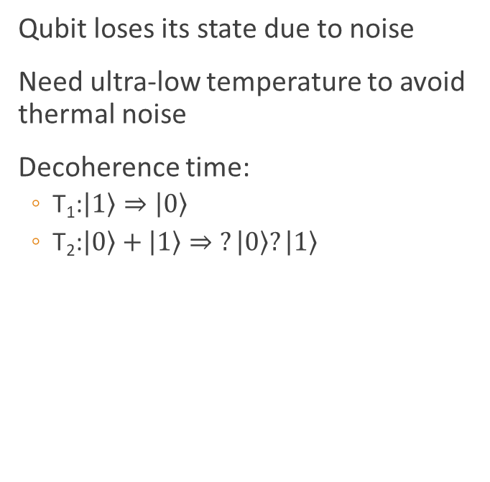
Noise, De-coherence Time and Energy Scale
Qubit loses its state due to noise
Need ultra-low temperature to avoid thermal noise
Decoherence time:
T₁:$\left.\left|1\right.\right\rangle ⇒\left.\left|0\right.\right\rangle$
T₂:$\left.\left|0\right.\right\rangle +\left.\left|1\right.\right\rangle ⇒\left.?\left|0\right.\right\rangle ?\left.\left|1\right.\right\rangle$
Qubit energy separation
Liquid-He
Dilution Fridge
Liquid-N

Slide 9

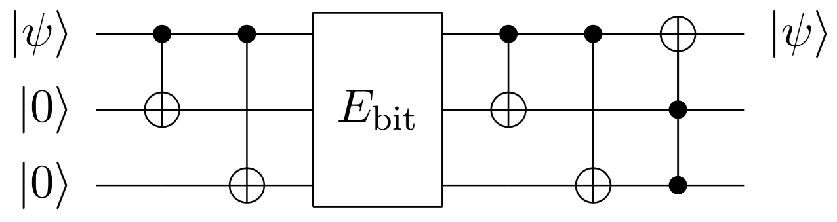

Error Correction
No-Cloning Theorem: It is not allowed to copy an arbitrary state in quantum mechanics
Syndrome measurement is used for error correction
Classical Error Correction
Quantum Error Correction
$$0⇒000$$
$$1⇒111$$
E.g. Through entanglement and syndrome measurement

Slide 10
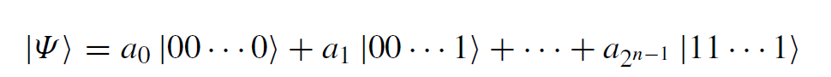
Final Remark: Is Quantum Computing Omnipotent?
Each state contains profound amount of information, but we cannot extract them with reasonable resources. How do we get the a’s?
QC is suitable for answering questions that classical computers cannot answer well. Often, destructive and constructive interferences are used to obtain the answers.
E.g. Is the function balanced? What is the period of the function?
QC cannot replace classical computer but can be a very powerful accelerator for difficult problems, e.g. optimization problems.

Slide 11
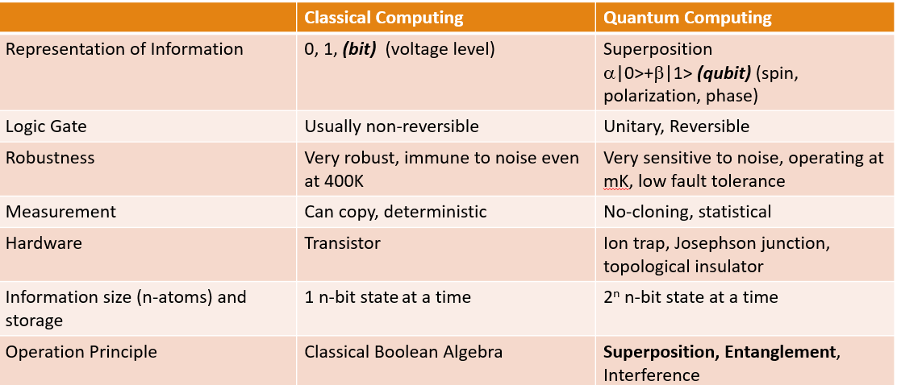
What did we learn in the last lecture?
Why Complex number is needed in QM?
https://aapt.scitation.org/doi/10.1119/10.0000258

Slide 12
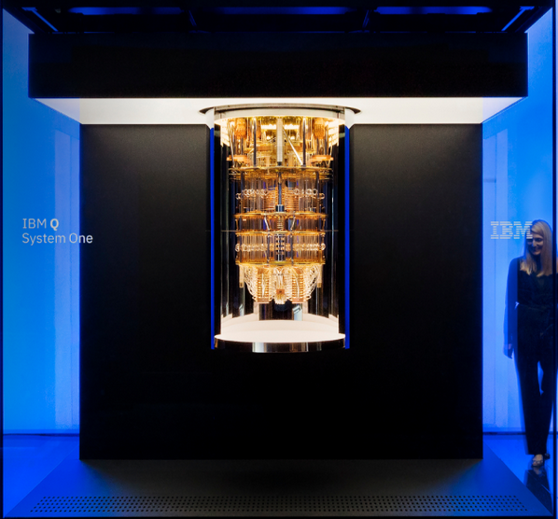
Quantum Computing – An Overview

Slide 13
Resources
IBM Quantum Experience
https://quantum-computing.ibm.com/
Learn Quantum Computing using Qiskit
https://qiskit.org/textbook/preface.html
Google Co-lab
https://colab.research.google.com/

Slide 14
Why Quantum Computing
Good at doing optimization problems (Quantum Annealing, QAOA, Quantum approximation optimization algorithm)
Software design, logistics, finance, Web search, genomics, machine learning
Simulating the nature (Analog Machine)
Chemical bonding
Drug discovering
General Purpose:
Prime number decomposition (Shor’s Algorithm)
Rapid unstructured search (Grover’s Algorithm)
Others: You can be the one to find the near term usage!

Slide 15
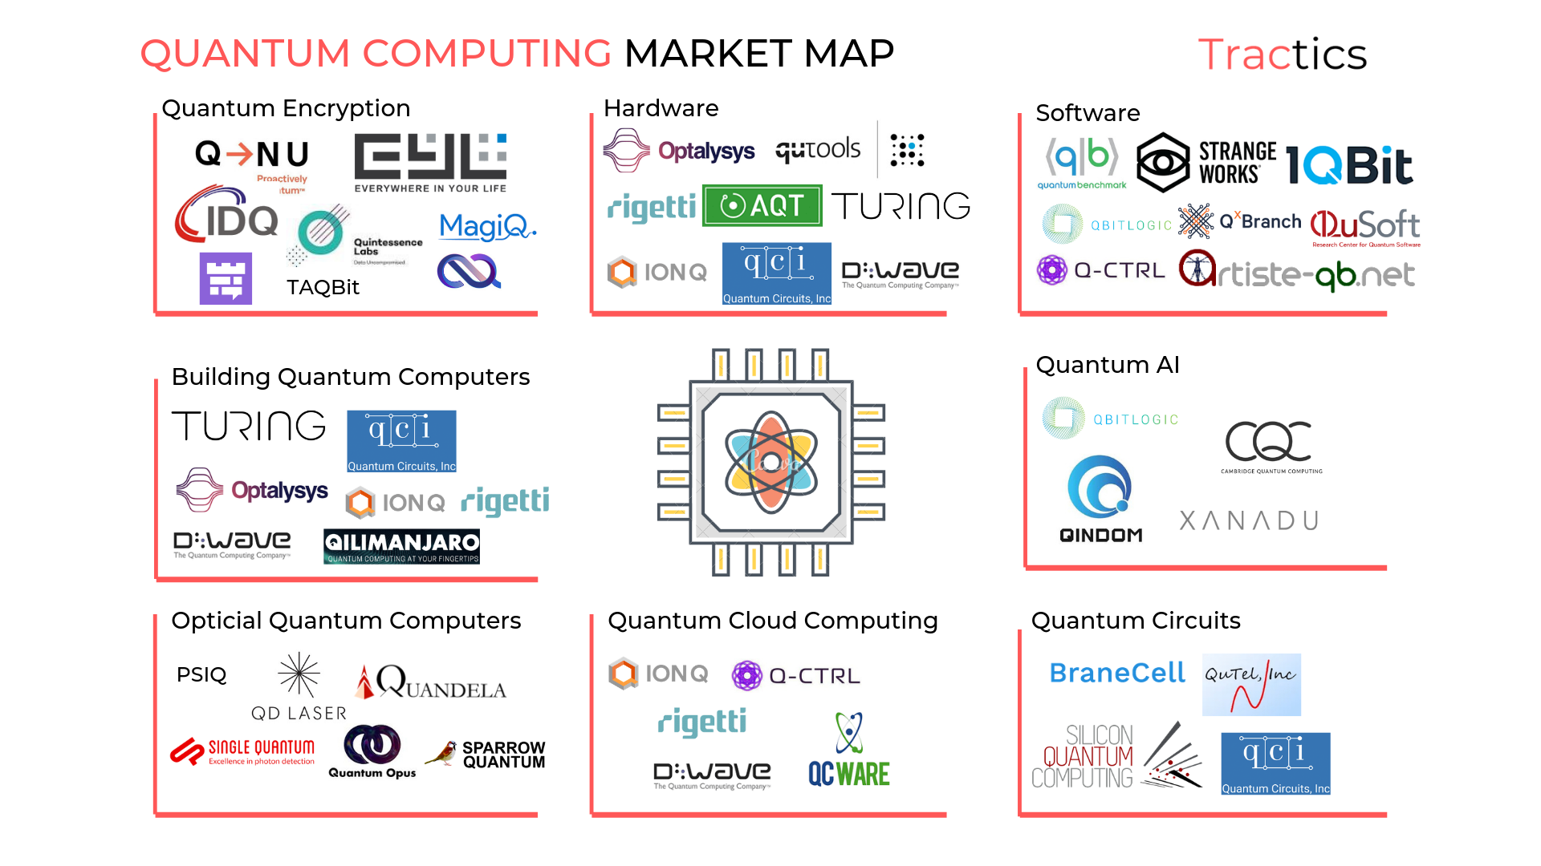
Current Landscape
https://medium.com/datadriveninvestor/quantum-computing-73-companies-that-are-changing-the-computing-landscape-f39ebf0ccfee

Slide 16
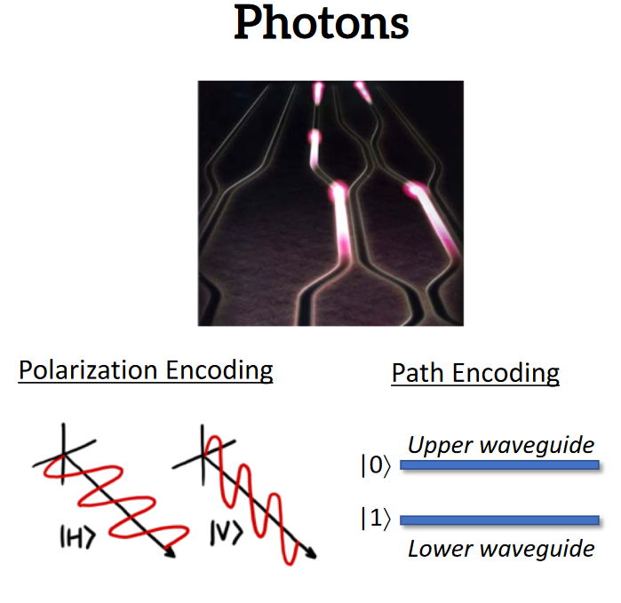
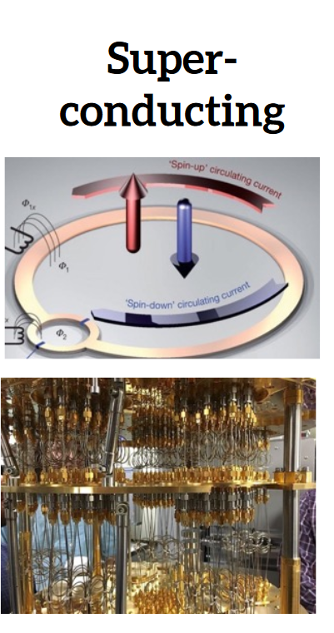
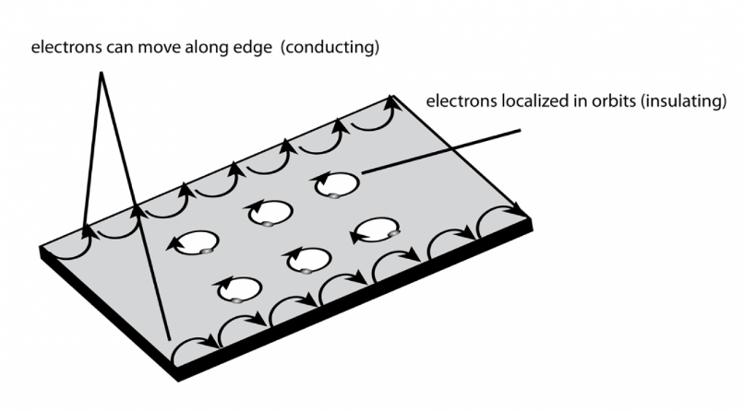
Qubit Realization
Microsoft | Intel | Google | IBM | PisQuantum
Topological Insulator | Josephson Junction | Josephson Junction | Josephson Junction | Photon
https://www.cadence.com/content/dam/cadence-www/global/en_US/documents/company/Events/summits/photonics/syrus-ziai-silicon-photonics-platforms-for-quantum-computing-2018.pdfs

Slide 17
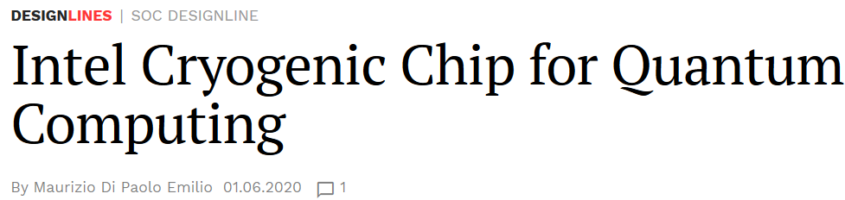
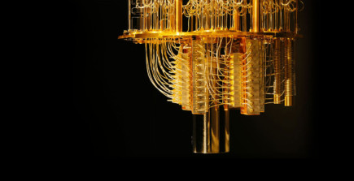
Opportunities
Quantum Hardware Design
Quantum Algorithm Design
Supporting hardware
Cryogenic CMOS
High Speed Digital Design
Noise engineering
DSP

Slide 18
How to Study?
We incorporate “Tutorial” feature in the lectures. A lot of hands-on.
Closed-book mid-term and exam. NO cheat sheet. => Must be easy!
Think of yourselves as first graders learning addition and multiplication.
Ask why but sometimes don’t ask why => Trust me and believe me
Able to repeat everything I teach in class, everything in assignments!
Goals:
You know the details of quantum computing not just BRAGGING or throwing fancy terms!
You might not understand everything but you know how it works (i.e. you can program the algorithms but in classical computers!)
It is a life-long learning!

Slide 19
Keep this in mind and bring to your interview
Niels Bohr: Anyone who is not shocked by quantum mechanics has not understood it.

Slide 20
How to study in a short time?
N. David Mermin:
Shut up and Calculate!

Slide 21
The Basics
Basic Mathematics and Quantum Mechanics

Slide 22


|Yes> or |No> Question (A joke)
Map these concepts to the analogy.
Basis (change of basis)
Superposition – we can calculate many states at the same time
Orthogonality
Wavefunction Collapse

Slide 23
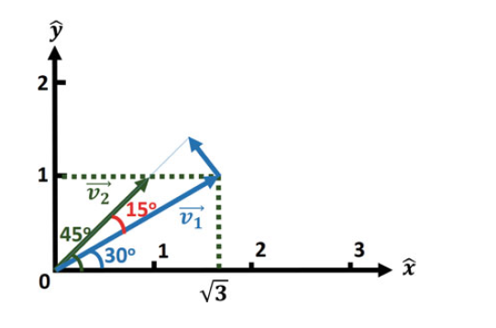
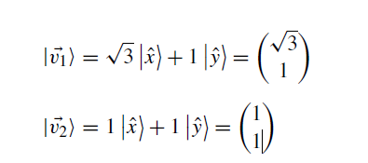
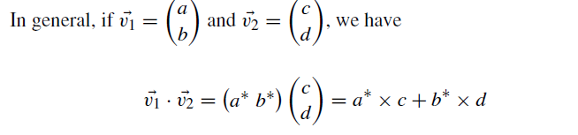

Vector Space and Basis

